Slide 1

#LifeKoKaroLift
Data Science Program
‹#›

Slide 2


Module Name: EDA & Statistics
Course : Statistics
Lecture On : Statistics - Day - 10
Instructor :
‹#›

Slide 3
Today’s Agenda
Revision
Understanding Hypothesis Testing
Null and Alternative Hypotheses
Making a Decision
Critical Value Method
Critical Value Method - Examples
The p-value method
The p-value method: Examples
Key Takeaways
Data Science Certification Program
‹#›

Slide 4

Revision
In previous session, we learnt about:
Uses of Sampling in Market Research
Uses of Sampling in Market Campaigns
Uses of Sampling in Pilot Testing
Uses of Sampling in Quality Control

Slide 5

Hypothesis Testing

Slide 6
Hypothesis Testing
Data must be interpreted in order to add meaning.
We can interpret data by assuming a specific structure of our outcome and use statistical methods to confirm or reject the assumption.
The assumption is called a hypothesis and the statistical tests used for this purpose are called statistical hypothesis tests.

Slide 7
Hypothesis Testing
Hypothesis testing is one important way to draw conclusions about the properties of a population.
You can use hypothesis tests to compare a population measure to a specified value, compare measures for two populations, determine whether a population follows a specified probability distribution, and so forth.
Thus, Through hypothesis testing, you can determine whether there is enough evidence to conclude if the hypothesis about the population parameter is true or not.

Slide 8
Types Of Hypothesis
Hypothesis Testing starts with the formulation of these two hypotheses:
Null hypothesis (H₀)
Alternate hypothesis (H₁)
The null hypothesis is a statement that’s assumed to be true unless there’s strong evidence against it.
The alternative hypothesis is a statement that is accepted if the null hypothesis is rejected.

Slide 9
Types Of Hypothesis
An example of a null hypothesis would be
'A defendant in a court is innocent' or 'A defendant in a court is not guilty'.
So, the corresponding alternate hypothesis would be
'A defendant is guilty'.
So, the rejection of the null hypothesis implies that the alternate hypothesis is true.

Slide 10
Null and Alternate Hypotheses
A null hypothesis is a hypothesis that says there is no statistical significance between the two variables in the hypothesis. It is the hypothesis that the researcher is trying to disprove.
A researcher is challenged by the null hypothesis and usually wants to disprove it, to demonstrate that there is a statistically-significant relationship between the two variables in the hypothesis.
An alternative hypothesis simply is the inverse, or opposite, of the null hypothesis.
Let’s look at an example:

Slide 11
Null and Alternate Hypotheses
Little Susie speculates, or hypothesizes, that the flowers she waters with club soda will grow faster than flowers she waters with plain water.
She waters each plant daily for a month (experiment) and proves her hypothesis true!
Susie's null hypothesis would be:
There is no statistically significant relationship between the type of water I feed the flowers and growth of the flowers.
The alternative hypothesis would be that:
There is indeed a statistically-significant relationship between what type of water the flower plant is fed and growth.

Slide 12
Null and Alternate Hypotheses
More specifically, for Susie's study:
Null: If one plant is fed club soda for one month and another plant is fed plain water, there will be no difference in growth between the two plants.
Alternative: If one plant is fed club soda for one month and another plant is fed plain water, the plant that is fed club soda will grow better than the plant that is fed plain water.
Additional Reading with more examples: Hypothesis

Slide 13

Making a Decision

Slide 14
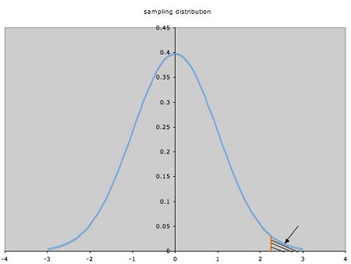
Making a Decision
This is one of the most important step of hypothesis testing where you decide to either reject or fail to reject the null hypothesis .
The boundary of this decision is known as critical point.
The critical value greater than mean value is Upper Critical Value (UCV).
The critical value lesser than mean value is Lower Critical Value (LCV).

Slide 15
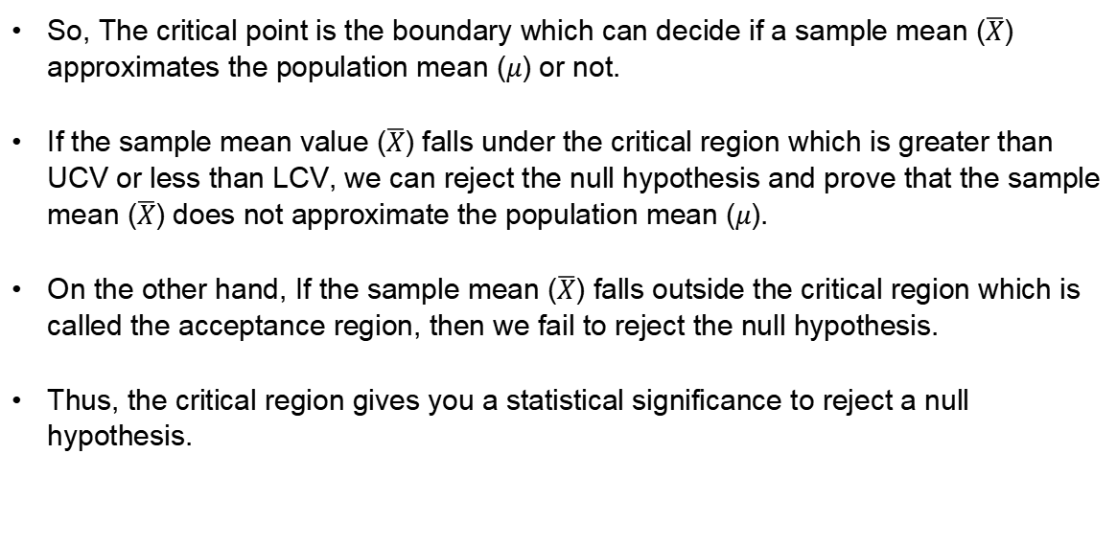
Making a Decision

Slide 16
Making a Decision
The critical region depends on the nature of the alternate hypothesis.
An alternate hypothesis can of two types: directional and non-directional.
Whenever you perform a non-directional hypothesis test, you need to check whether the population mean will lie towards the left or towards the right of the assumed mean.
Therefore, this type of test is called a two-tailed test because you have to check both the tails of the sample.
They are used commonly to test consistency and products, especially in the pharmaceutical industries.

Slide 17
Making a Decision
For e.g.,
Consider any medicine whose main component is paracetamol which helps reduce pain and fever of a patient.
It is important to have an optimal quantity (say 500 mg) of paracetamol in each tablet of the medicine.
If the quantity of paracetamol in a tablet is lower than 500 mg, then its efficacy will be lost and the patient will not feel any better after taking the medicine.
On the other hand, if the paracetamol quantity is more than 500 mg, then the medicine will cause some undesirable side-effects.
Hence, in this case, your null hypothesis would be that the average paracetamol quantity is 500 mg and you would want to fail at rejecting the null hypothesis.

Slide 18
Making a Decision
But there are cases when you want to find out whether the sample mean is lower or higher than the population mean.
In this case, the hypothesis test is called a one-tailed test and more specifically a lower tailed test OR a upper tailed test.
The formulation of the null and alternate hypotheses determines the type of the test and the position of the critical regions in the normal distribution.

Slide 19
Making a Decision
You can tell the type of the test and the position of the critical region on the basis of the ‘sign’ in the alternate hypothesis.
≠ in H₁ → Two-tailed test → Rejection region on both sides of distribution
< in H₁ → Lower-tailed test → Rejection region on left side of distribution
> in H₁ → Upper-tailed test → Rejection region on right side of distribution

Slide 20
Critical Value Method
After formulating the hypothesis, we have to follow some steps to make a decision using the critical value method:
1. Calculate the value of Zċ from the given value of α (significance level). Take it a 5% if not specified in the problem.
2. Calculate the critical values (UCV and LCV) from the value of Zċ.
3. Make the decision on the basis of the value of the sample mean x with respect to the critical values (UCV AND LCV).

Slide 21
Critical Value Method - Example
A manufacturer claims that the average life of its product is 36 months.
An auditor selects a sample of 49 units of the product and calculates the average life to be 34.5 months. The population standard deviation is 4 months.
Test the manufacturer’s claim at 3% significance level using the critical value method.
Formulate the hypotheses for this two-tailed test:
H₀:μ = 36 months
H₁: μ ≠ 36 months

Slide 22
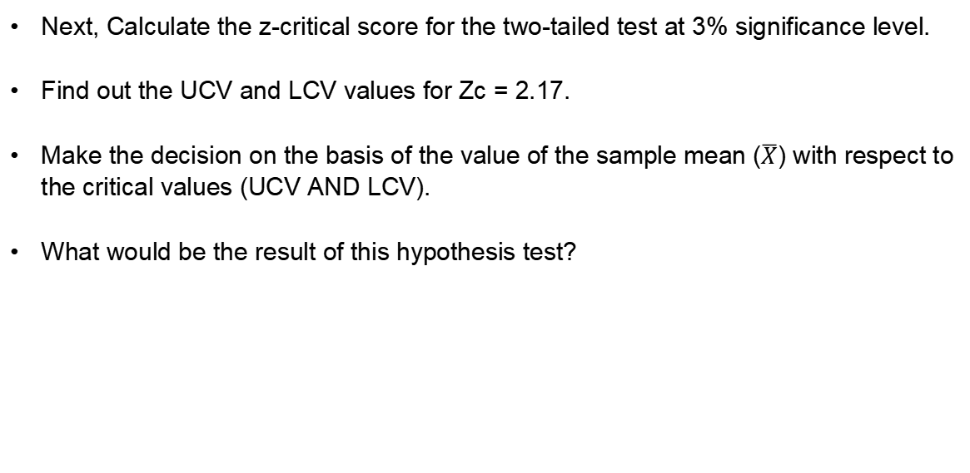
Critical Value Method - Example

Slide 23
P-Value Method
This is one of the important methods for making a decision. It is defined as the probability of the null hypothesis being accepted (or more aptly, not being rejected)
This statement is not technically correct (or formal) definition of p-value, but it is used for better understanding of the p-value.

Slide 24
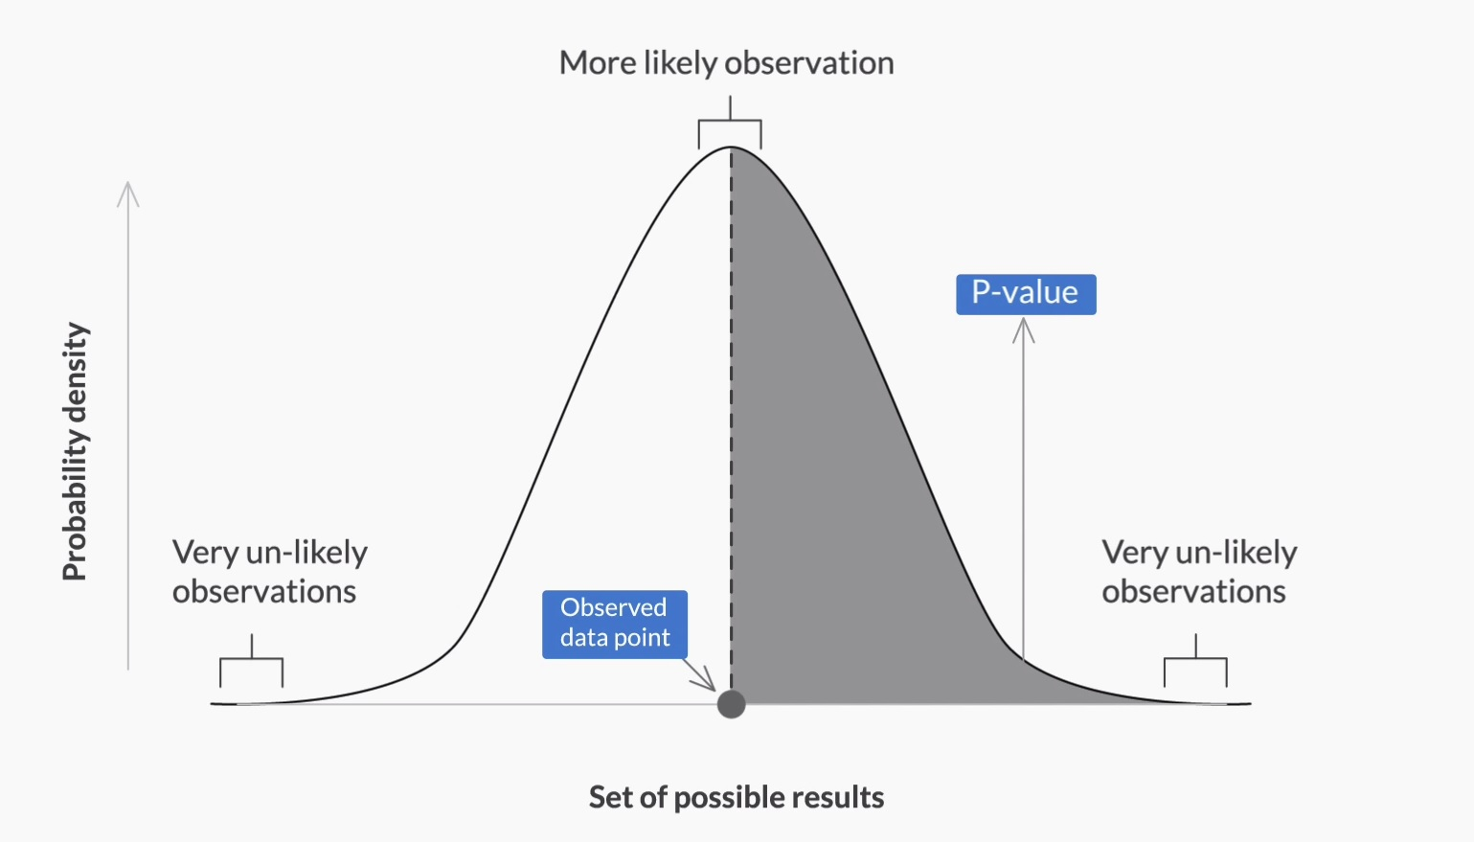
P-Value Method
Suppose the test statistic in a hypothesis test is equal to K.
The p-value is the probability of observing a test statistic as extreme as K, assuming the null hypothesis is true.
If the p-value is less than the significance level, we reject the null hypothesis, as shown in the figure below.

Slide 25
P-Value Method
So, higher the p-value, higher is the probability of failing to reject a null hypothesis.
On the other hand, lower the p-value, higher is the probability of the null hypothesis being rejected.

Slide 26
P-Value Method
After formulating the null and alternate hypotheses, the steps to follow in order to make a decision using the p-value method are as follows:
Calculate the value of z-score for the sample mean point on the distribution
Calculate the p-value from the cumulative probability for the given z-score using the z-table
Make a decision on the basis of the p-value (multiply it by 2 for a two-tailed test) with respect to the given value of α (significance value).

Slide 27
P-Value Method
For eg:
Let’s say z-score for sample point = + 3.02. This mean sample mean is on the right side of the distribution mean.
So, The Cumulative probability of sample point from z-table = 0.9987
For one-tailed test → p = 1 - 0.9987 = 0.0013
For two-tailed test → p = 2 (1 - 0.9987) = 2 * 0.0013 = 0.0026

Slide 28
P-Value Method
Similarly,
If the z-score for sample point = -3.02, then the sample mean is on the left side of the distribution mean.
In this case, Cumulative probability of sample point = 0.0013
For one-tailed test → p = 0.0013
For two-tailed test → p = 2 * 0.0013 = 0.0026

Slide 29
P-Value Method - Example
You work at a pharmaceutical company that manufactures an antipyretic drug in tablet form, with paracetamol as the active ingredient.
An antipyretic drug reduces fever. The amount of paracetamol deemed safe by the drug regulatory authorities is 500 mg.
If the value of paracetamol is too low, it will make the drug ineffective and become a quality issue for your company.
On the other hand, a value that is too high would become a serious regulatory issue.

Slide 30
P-Value Method - Example
There are 10 identical manufacturing lines in the pharma plant, each of which produces approximately 10,000 tablets per hour.
You have the time and resources to take about 900 sample tablets and measure the paracetamol content in each.
Upon sampling 900 tablets, you get an average content of 510 mg with a standard deviation of 110.
What does the test suggest, if you set the significance level at 5%?
Should you be happy with the manufacturing process or should you ask the production team to alter the process? Is it a regulatory alarm or a quality issue?

Slide 31
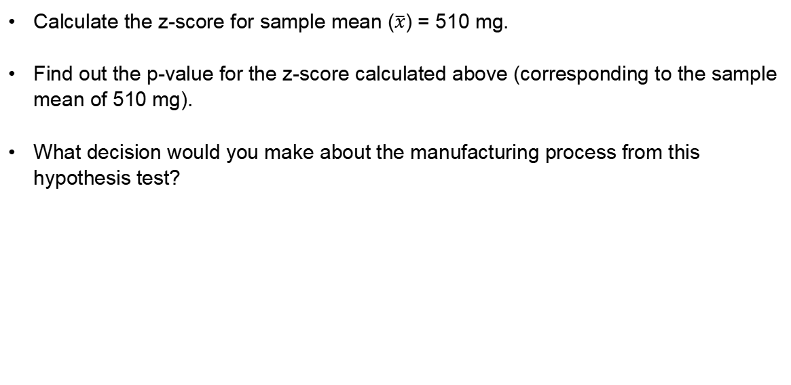
P-Value Method - Example

Slide 32
Key Takeaway
Revision
Understanding Hypothesis Testing
Null and Alternative Hypotheses
Making a Decision
Critical Value Method
Critical Value Method - Examples
The p-value method
The p-value method: Examples
Key Takeaways
Data Science Certification Program
‹#›

Slide 33
#LifeKoKaroLift
Thank You!
‹#›

